Slide 1


AIRLINE SYSTEM
Presented by:
GROUP E
INSTRUCTOR:
Mr. BHAVIK GANDHI

Slide 2




GROUP MEMBERS
ABISHEAK DHANABAL(C0903766)
ALWIN KANNYAKONIL SCARIA (C0894287)
ASHNA VIJI ALEX(C0901082)
JERIN THENGUMPALLIL THOMAS (C0896235)
KUNCHERIA TOM(C0900973)
PRINCE THOMAS (C0894907)
MOHAMED AFTAB (C0891945)

Slide 3
INTRODUCTION
This project is based on the valuable data of US airlines which includes various flights operators, flown flights, various airports, regarding the number of delays and cancellations.
01
The data serves as a crucial resource for analyzing the performance of airlines and identifying areas for optimization.
02
This database helps to identify the issues associated with existing flight schedule system.
03
We primarily focused on resolving the root causes of delays, cancellations and diversions that cause immense operational cost, time and resource wastage rather than passenger analysis.
04

Slide 4
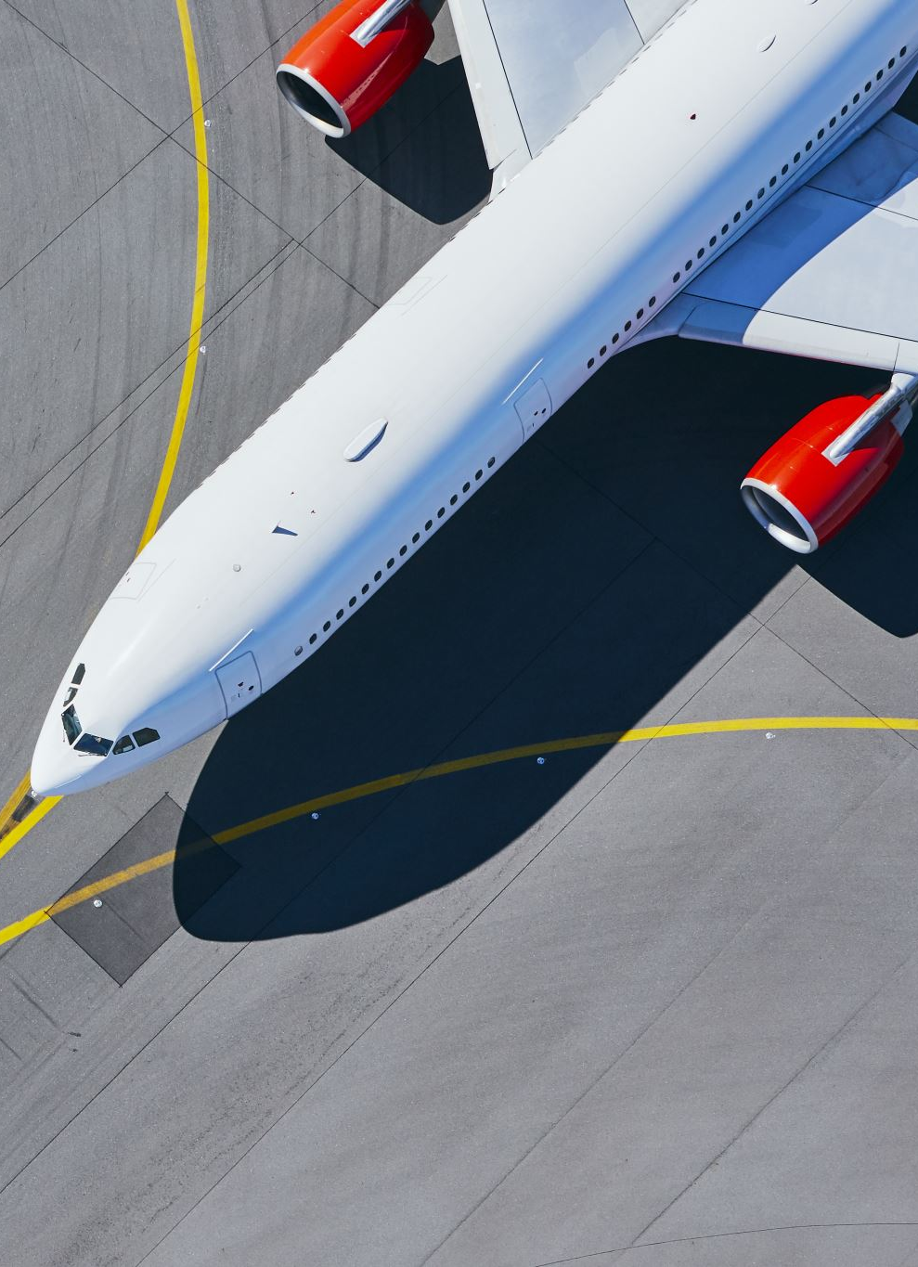
HOW THE US DOMESTIC AIRLINES WORKS
US domestic airlines operate within a complex system that involves various components and processes to ensure safe and efficient air travel.
They have vast networks connecting major cities, regional airports.
U.S domestic airlines are part of global airline alliances.
US airlines use various pricing strategies, including dynamic pricing based on demand, booking time, and seat availability. They also offer different fare classes with varying levels of service and amenities, such as economy, premium economy, business, and first class.
References:- https://www.bts.gov/ (Bureau of Transportation statistics)

Slide 5
PROBLEMS
Consequences of Departure Delay
Flight Diversion Implications
Aging Aircraft Maintenance
Impact of Climatic Conditions
Inexperienced Pilots and Safety
Environmental Concerns

Slide 6

OPPORTUNITY
Enhancing fuel efficiency and reducing disruptions
Strategic flight scheduling
Maintaining reliable travel
Addressing delayed and cancelled flights
Efficient aircraft assignment
Minimizing losses during cancellations
Addressing aircraft issues

Slide 7
DIFFERENTIATION
Main aspects and future usages of this airline system when compared to others:
As this project is based on US Airline system, the existing systems mainly focuses on only net-income and revenue.
Whereas this system provides updates of flight and the airline company based on climate factors, security, etc.
This system considers factors like airport congestion, airline-specific issues, and air traffic control delays to determine the cause of the delay.
Provides an optimal and low-cost maintenance system which helps the users to get complete details of an airline.

Slide 8
ANALYSIS
By examining the delay and cancellation data, airlines can identify common causes of delays and cancellations.
From this system, the users/company will be able to schedule flights by checking other flights delay, cancelled and scheduled timing.
Based on the geographical insights and taxi-on off timings, optimized airport selection and taxi timing.
User-friendly experience.
Understand flight cancellations.
Identify airlines with high delay rates.

Slide 9
INSIGHTS
Delay of flight on daily basis
Causes of a flight cancelled
Duration of flight runtime
Airport congestion
Diversion

Slide 10
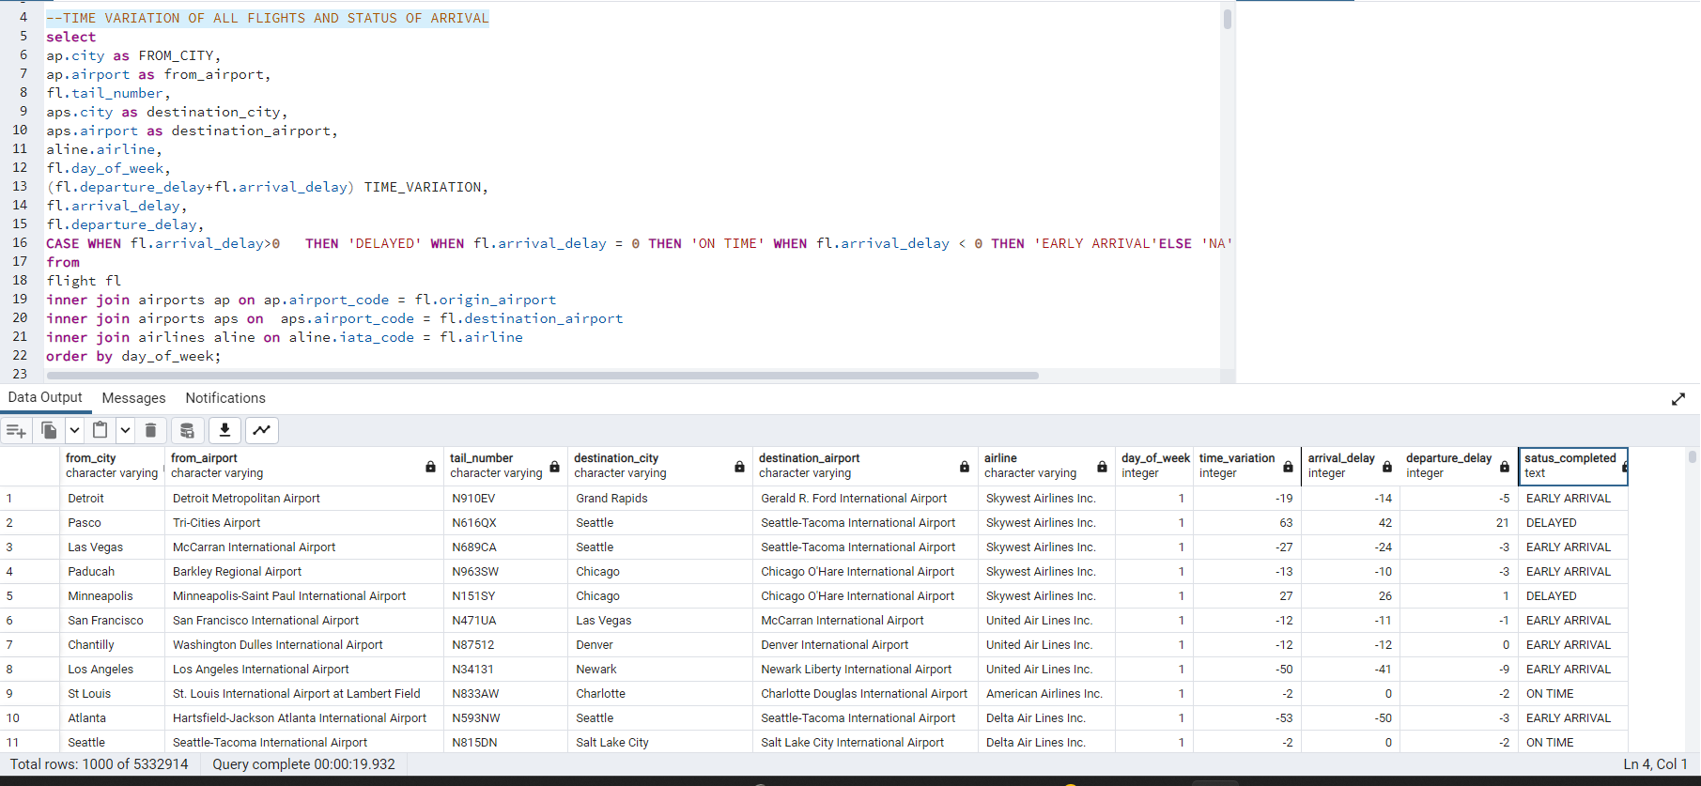
1. TIME VARIATION OF ALL FLIGHTS AND STATUS OF ARRIVAL
SQL CODES & INSIGHTS
Analyses the general pattern of each flight on its delay by comparing the arrival & destination delays.
In sight: Majority of flights fail to departure/ arrive at scheduled time. Need to investigate more on this to identify the cause and need to look by airlines and airports statistics. Identified as serious issue in airline industry.

Slide 11
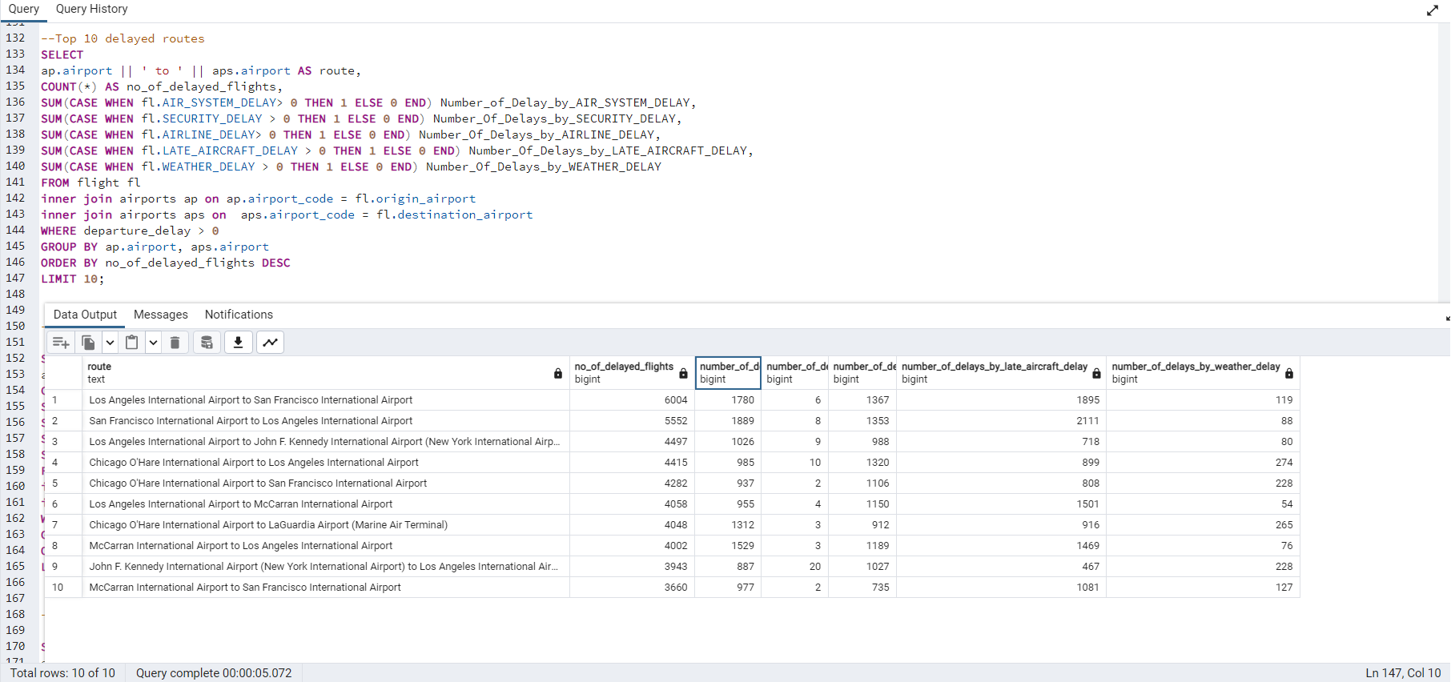
2. TOP 10 DELAYED ROUTES
Checking the highly delayed top 10 routes in U.S
Insight: Los Angeles to and from San Francisco is the highly delayed route, as well as routes involving airports like John F Kennedy, Chicago and McCarran are reported to be most delayed.

Slide 12
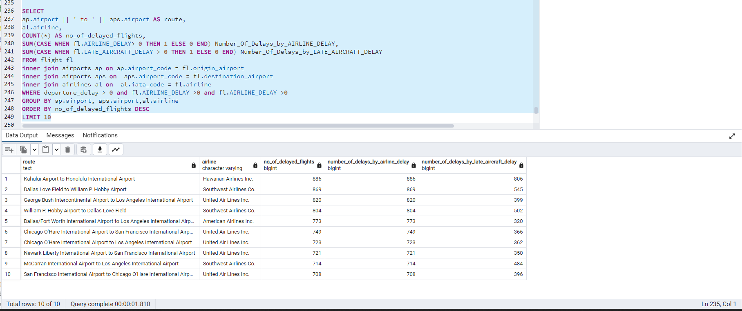
3. TOP 10 DELAYED ROUTES BY AIRCRAFT ISSUES
To find the aircraft which is having high delay rate and top 10 routes which is delayed due to aircraft issues .
Insight: Hawaiian Airlines is the aircraft causing the highest number of delays in the Kahului to Honolulu airport and United Air Lines is the aircraft having the highest number of delays

Slide 13
HADOOP - MAPREDUCE
Using Hadoop cluster, MapReduce programs were executed which provided insights on:
Average delay of airline/flight on different days of a week
Number of flights and distance travelled based on category of HAUL (flight distance)
Average delay by airline

Slide 14
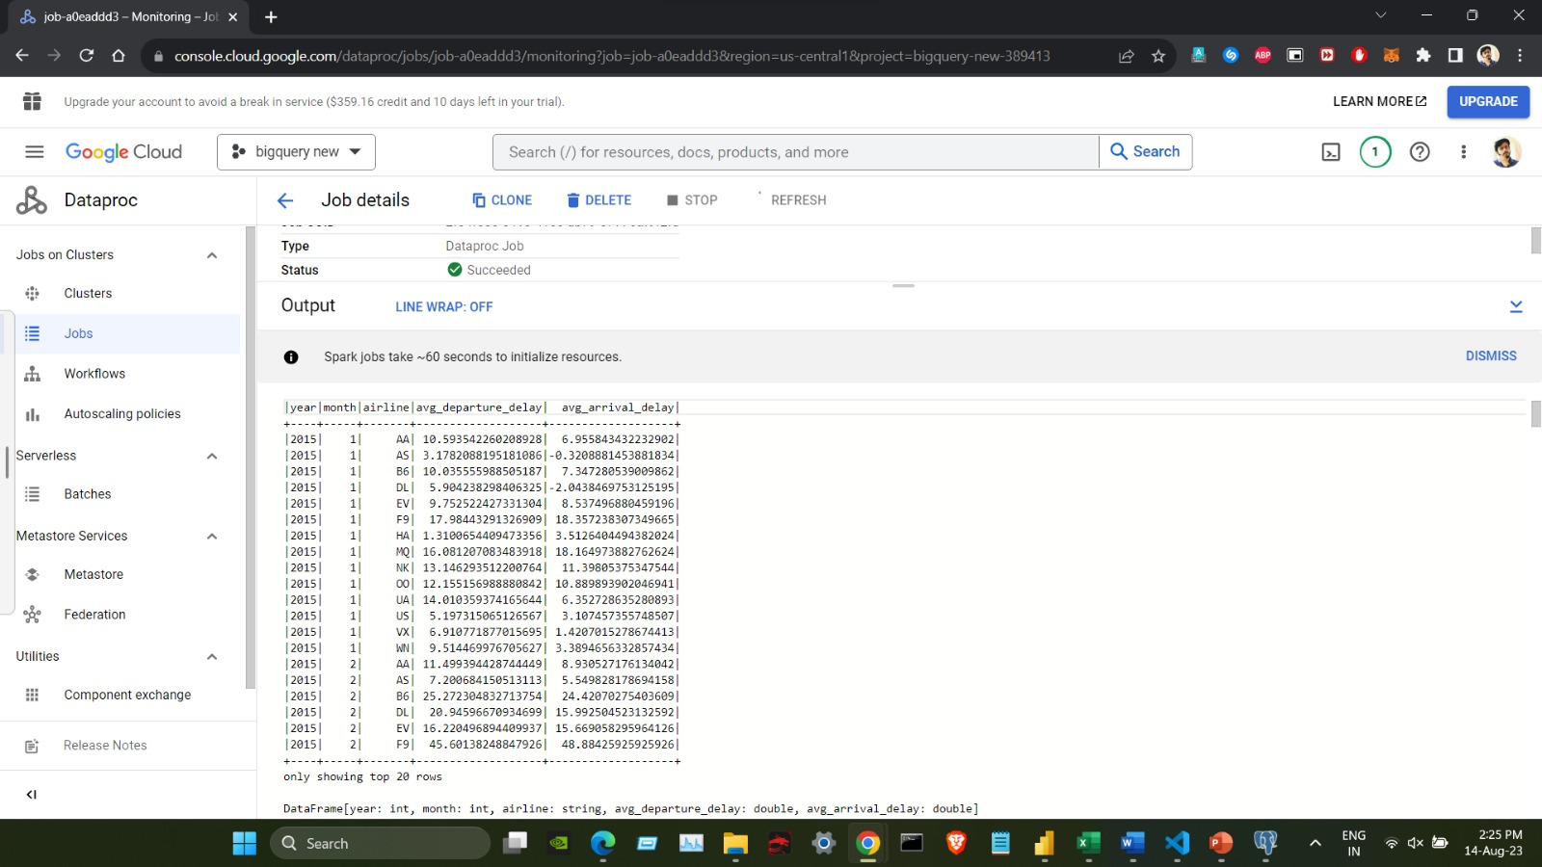
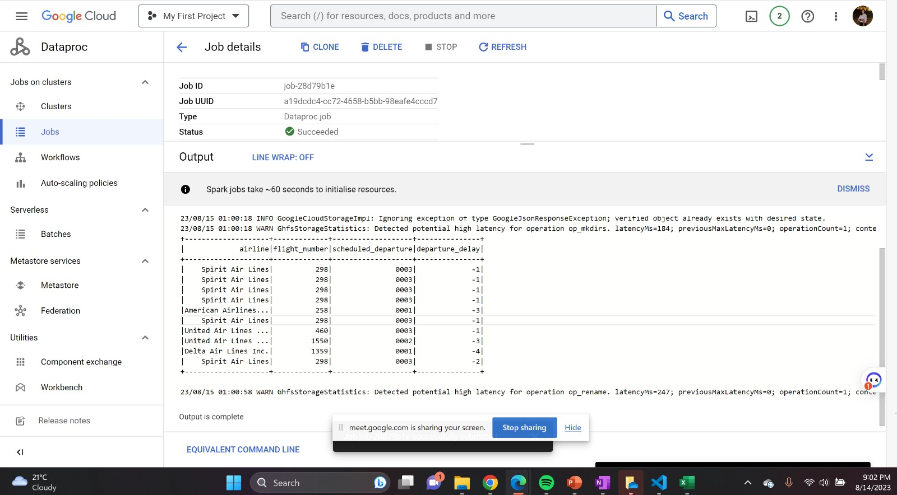
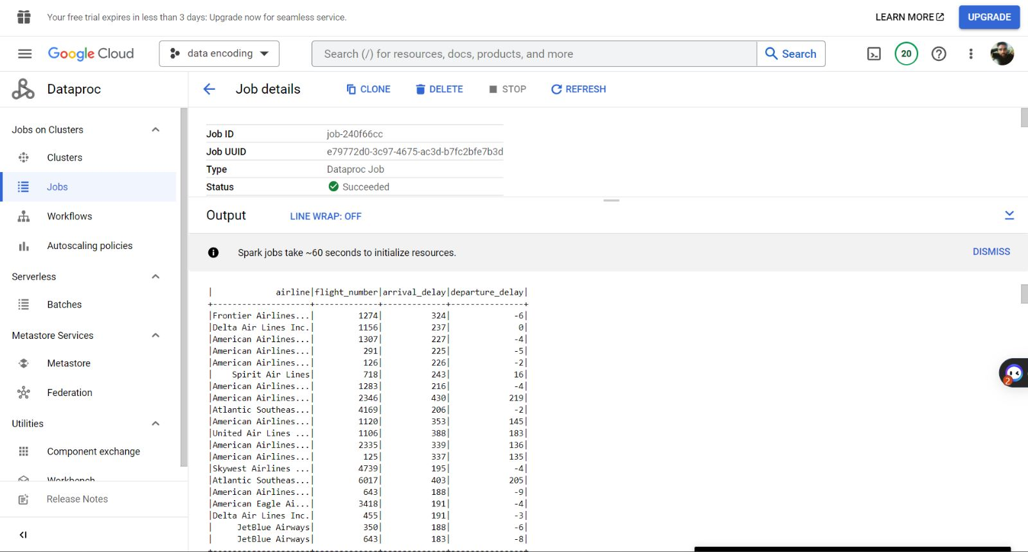
Spark Jobs
Average departure and arrival delays for each airline based on year and month
Flights that departed earlier than their scheduled departure time
Flights with highest arrival delay

Slide 15

VISUALIZATION

Slide 16
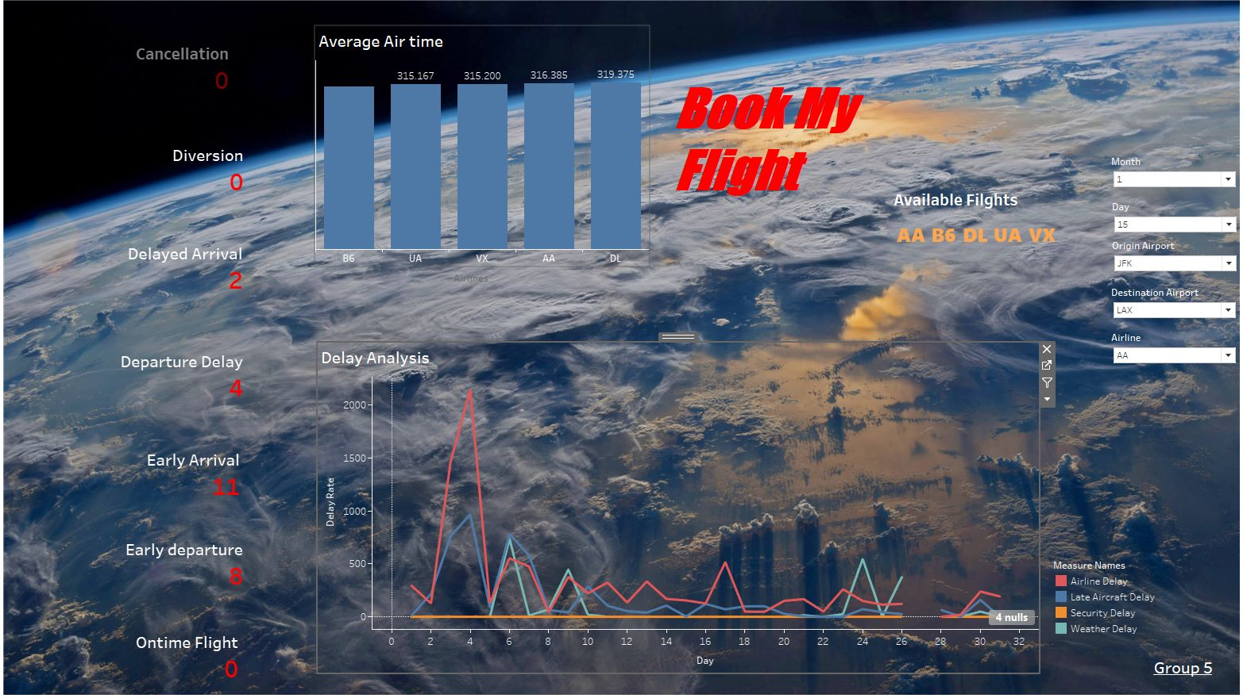
DASHBOARD
The dashboard is dynamic and provides results regarding a flight delay due to airline-delay, late aircraft delay, security delay, weather delay.
Average airtime for each aircraft based on the user mentioned airport is obtained.
Based on the inputs provided by the user, the dashboard updates on the available flights from the origin airport.
The dashboard also provides better understanding of:
how many cancellations was happened to the airline
diversion taken
delayed arrival count, departure delay count, early arrival,
early departure and on time flight is gained.

Slide 17
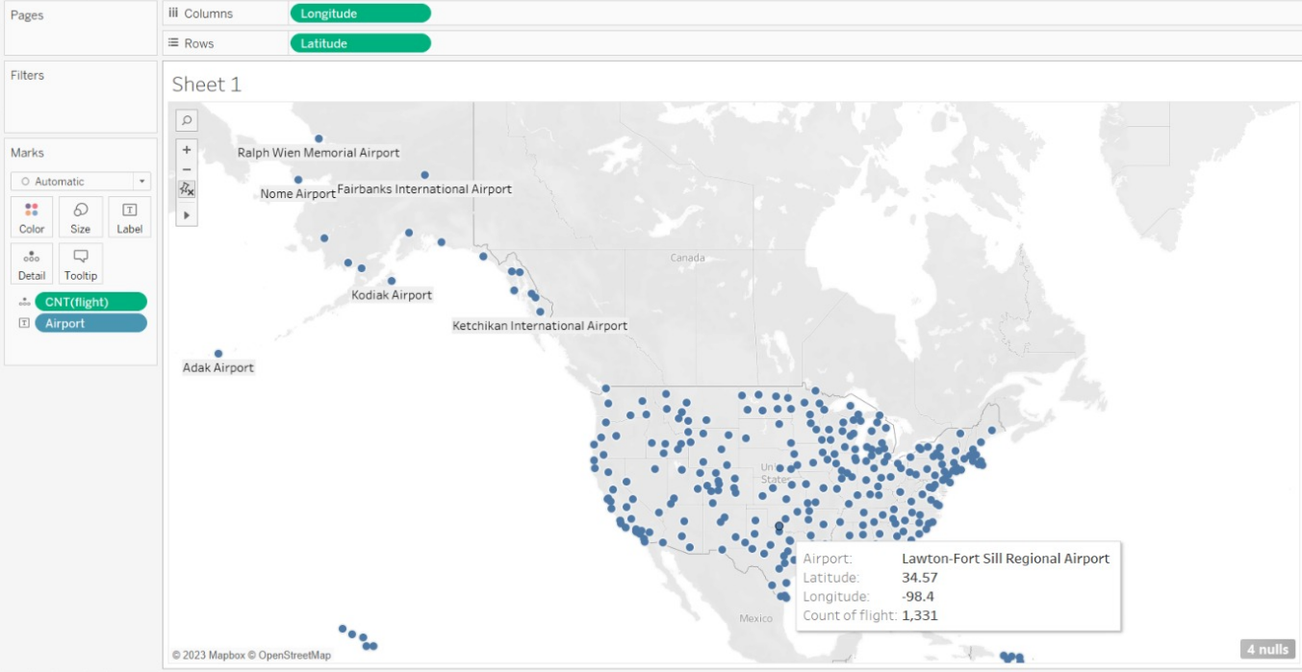
Total number of flights from airports
This is a scatter plot chart which provides understanding about:
the number of flights flown from the origin airports
Latitude
Longitude
Airport

Slide 18
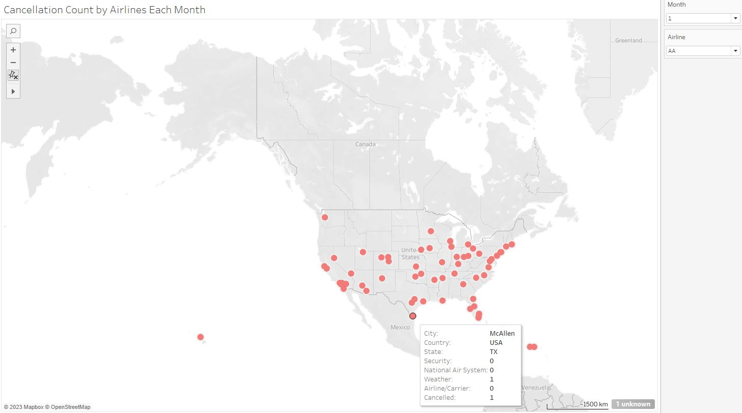
Cancellation count by airlines for each month
This is a scatter plot chart which provides understanding about:
the count of airlines which was cancelled due to some specific reasons on a specific month.
Count of cancellation
Place (state, country, city)
Cancellation reason count

Slide 19
CONCLUSION
On the analysis of the dataset, we found that delay, cancellations, and diversion leads to performance issue in the domestic airlines industry.
We also found a common pattern by airports, airlines and season that are usually delayed.
By identifying the patterns from historic data, we could minimalize the root cause of the issues and enhance the industry performance up to a great extent.
Also, got more hands-on experience in different tools and technologies.

Slide 20
THANK YOU

